Slide 1
Pitcher Accuracy Metric (PAM)
Jordan Brooks, Tony Rollin, David Hoke

Slide 2
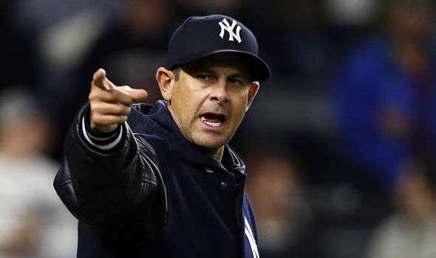
Aaron Boone
New York Yankees Manager
Needs to win games to keep job
Only wants what’s best for team
Extremely competitive
Data Analytics supporter
Calm personality

Slide 3
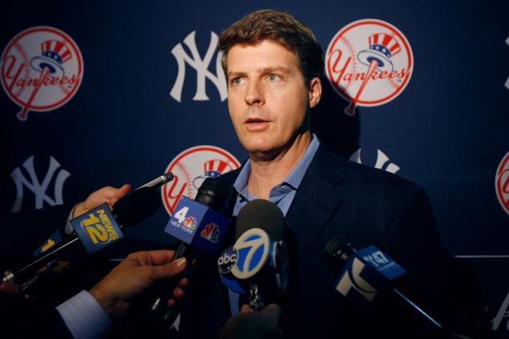
Hal Steinbrenner
Yankees Owner
Trade talks
Movement through farm leagues
Pressure from other executives
Pressure of owning prestigious club
Prideful
Notes:
Profit is the main goal for an owner
The new PAM will add another layer of statistics, and therefore accuracy to the ability to rank talent
Has to deal with many stakeholders in mind like the owners, executives and fans
The Yankees have a winning culture which ties to the fans and pride for the team

Slide 4
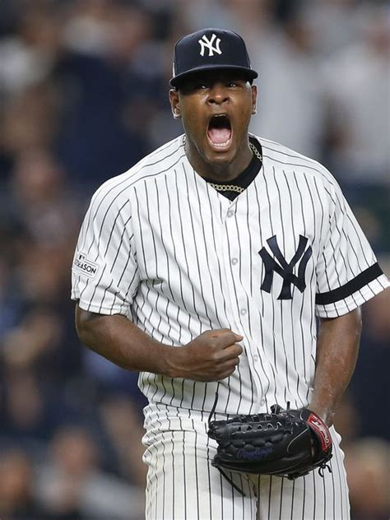
Luis Severino
Yankees pitcher
Know which pitches are most accurate
Use best pitches at correct time
Extremely competitive
New to data analytics
Stubborn personality

Slide 5
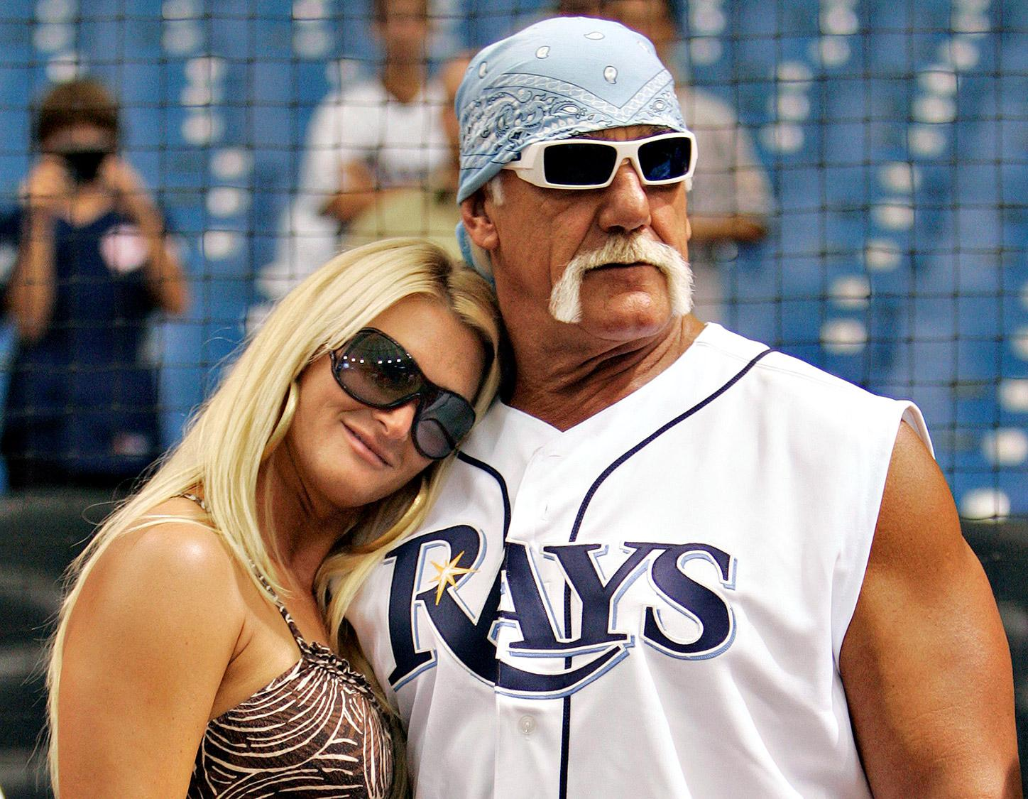
Hulk Hogan
Baseball fan
Statistics junkie
Loves attending games
Love watching game on TV
Follows Cy Young race closely
Don’t insult his team or he will kick your ass
Facial hair enthusiast

